Slide 1
Intro to Quant Finance
Brilliant.org

Slide 2
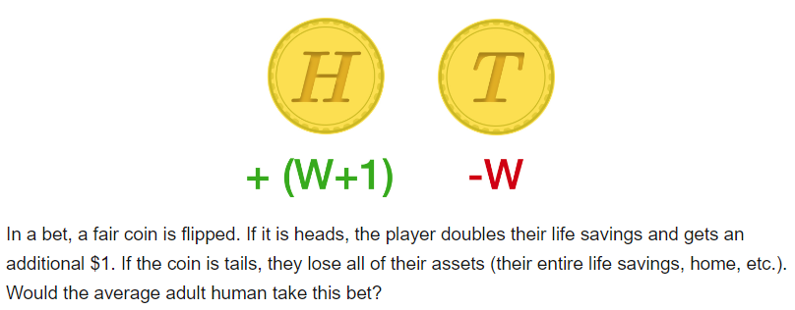
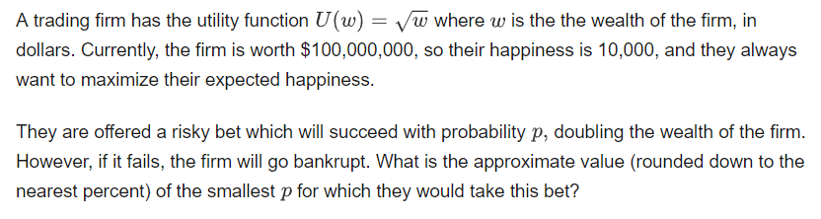


Financial Models
While financial “experts” can still provide insights and make key decisions, the new heroes are math, statistics, and computer science.
The massive amount of trading data – and the frequency at which trading occurs – is a major reason why quantitative methods and automated algorithms have become a bedrock of Wall Street. For example there are about 100 trades per second being executed on the NYSE during a normal trading day.
Under “normal” conditions (e.g. not around earnings reports), it is often reasonable to model a stock price as a random variable. With no information about a stock, multiplying or dividing the stock’s price by 1.001 each minute with equal probability is a fairly good model.
With any probabilistic model, the usefulness of the model is dependent on the validity of its underlying assumptions. For example, mortgage default are often correlated. Therefore, building a model based on uncorrelated default risk would be problematic. In such a construction, the model may severely underestimate the probability of mass default.
Expected value and risk must be considered together. For example, the bet shown below has a positive expected value of $0.50, however, this level of positive expectation would hardly incentivize anyone to take this bet.
One must consider an investor’s utility function (happiness versus wealth) when gauging risk versus reward tradeoffs.
Probability
Statistics
Correlation
Variance
Expected Value
Markov Chain
$$Expected Utility=\left(1−p\right)\sqrt{0}+p\sqrt{200M}=p\sqrt{2}\sqrt{100M}$$
Quantitative Financial Models
$$p\sqrt{2}\sqrt{100M}>\sqrt{100M}$$
$$p>\frac{1}{\sqrt{2}}=70.7\%$$

Slide 3
Probability in Quantitative Finance
Financial markets are full of uncertainty. Therefore, the ability to quantify that uncertainty and make predictions is a key function in quant finance.
A clever approach in solving probability problems is through examining the symmetry between different random variables.
Modeling the likelihood of change is key in quant finance. For example, modeling whether a stock will go up or down with some probability over some time interval. This type of model, when taken at very small time intervals, actually forms the basis of some more complex models in quant finance.

